Slide 1

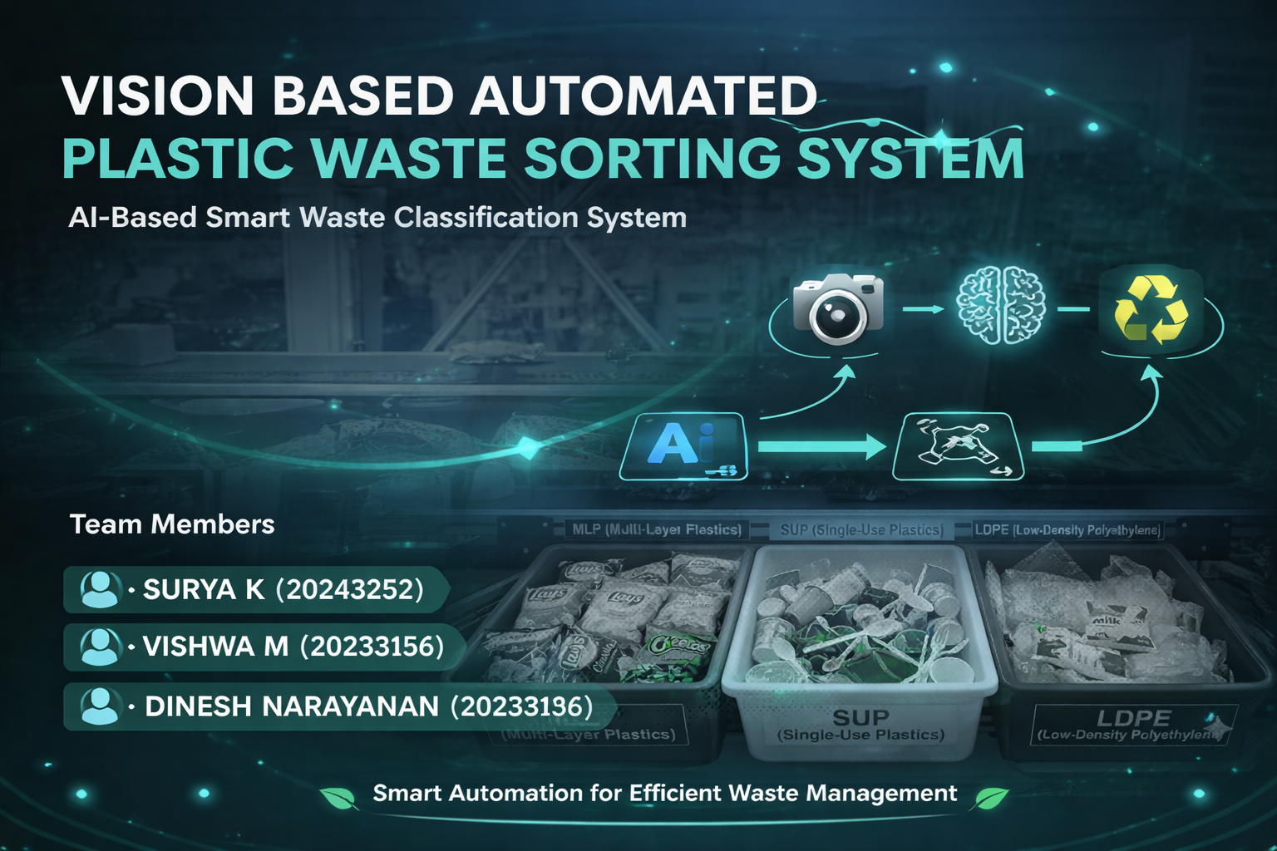

Slide 2
Introduction:
The rapid increase in plastic waste has become a major environmental concern across the world. Improper waste segregation leads to pollution, inefficient recycling, and increased landfill usage. Traditional manual sorting methods are time-consuming, labor-intensive, and often inaccurate.
To address these challenges, the Vision-Based Automated Plastic Waste Sorting System is developed as an intelligent and efficient solution. This system uses a camera and image processing techniques to identify different types of plastic waste, such as LDPE, MLP, and single-use plastics.
The system is powered by artificial intelligence (AI) and a microcontroller, which work together to analyze the captured images and classify the waste in real time. Based on the classification, the system automatically directs the waste into the appropriate category using servo motors or mechanical sorting mechanisms.
This project aims to improve waste management by reducing human effort, increasing sorting accuracy, and promoting recycling efficiency. It also contributes to environmental sustainability by enabling smarter and cleaner waste handling practices.

Slide 3
OBJECTIVES:
The main objectives of the Vision-Based Automated Plastic Waste Sorting System are:
To design and develop an automated system for sorting plastic waste using vision-based technology.
To identify and classify different types of plastic materials such as LDPE, MLP, and single-use plastics.
To reduce manual effort and improve the efficiency of waste segregation.
To increase sorting accuracy using image processing and artificial intelligence techniques.
To implement real-time detection and automatic sorting using a microcontroller and servo motors.
To promote effective recycling by separating waste into appropriate categories.
To develop a cost-effective and scalable solution suitable for smart waste management systems.

Slide 4
COMPONENTS USED:
🔧 Hardware Components:
💻 Software Components:
Web Camera
Used to capture real-time images of plastic waste for detection and classification.
Arduino (Microcontroller)
Acts as the main controller to process signals and control the sorting mechanism.
Servo Motors (2 Units)
Used to direct and sort the detected plastic waste into different categories.
Website (User Interface)
Provides a platform to display detection results and system status.
OpenCV
Used for image processing and capturing frames from the camera.
YOLO (You Only Look Once)
A deep learning algorithm used for real-time object detection and classification.

Slide 5
WORKING PRINCIPLE:
The Vision-Based Automated Plastic Waste Sorting System operates by combining image processing, artificial intelligence, and hardware control to automatically detect and sort plastic waste.
Initially, a web camera continuously captures images of the objects placed on the conveyor or sorting area. These images are processed using OpenCV, which prepares the frames for analysis.
The processed images are then passed to the YOLO (You Only Look Once) algorithm, which detects and classifies the type of plastic waste (such as LDPE, MLP, or single-use plastics) in real time.
Once the object is identified, the classification result is sent to the Arduino microcontroller. Based on the detected category, the Arduino controls the servo motors to move in specific directions.
The servo motors guide the waste into the correct bin or section, ensuring proper segregation. This entire process happens automatically and quickly, without human intervention.
Thus, the system achieves efficient, accurate, and real-time plastic waste sorting using vision-based technology.

Slide 6
ADVANTAGES:
Automatic Waste Sorting
Fully automated system reduces human effort and manual work.
High Accuracy using AI
YOLO-based detection ensures precise classification of plastic waste.
Fast & Real-Time Processing
Quickly detects and sorts waste, saving time.

Slide 7
CONCLUSION:
The Vision-Based Automated Plastic Waste Sorting System was successfully developed to improve waste segregation using AI and automation. The system accurately detects and classifies plastic waste using the YOLO algorithm and automatically sorts it using servo motors.
This project reduces manual effort, increases efficiency, and promotes effective recycling. It demonstrates how modern technologies like computer vision and embedded systems can be used to solve real-world environmental problems.
Overall, the system is reliable, cost-effective, and has strong potential for future development in smart waste management.

Slide 8


